Slide 1
EECE5001 Week 2
TOPICs
Team Formation - Bios of team members
[work and coop experiences].
One Member of Existing Team gives 1-2 minute presentation
Each Student Without a Team gives 2 minute presentation
[of type of team wants to join, etc]
Ethics
What happened at Boeing?
WEEKLY ASSIGNMENTS
Dym Chapters 15-17: Team
Make Entries Into DHF 4a.

Slide 2
EECE5001 Week 2
Team Formation - Bios of team members
[work and coop experiences].
Core considerations:
Goal(s) of project
Budget planned
Skill levels required
Minimum number of Tasks for success
Time factor
Secondary considerations:
Faculty adviser versus external adviser
Location [lab space versus field]

Slide 3
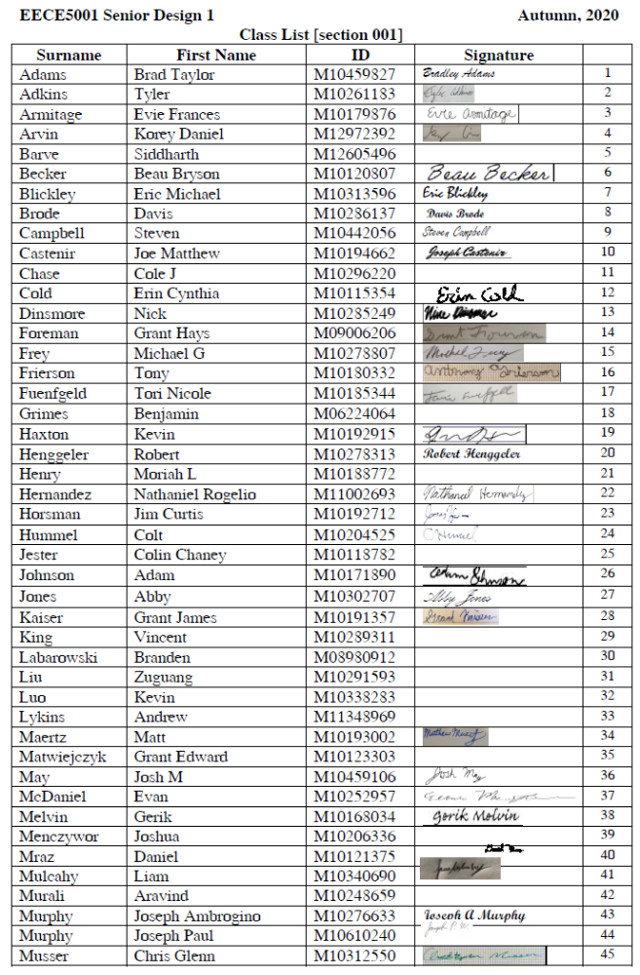
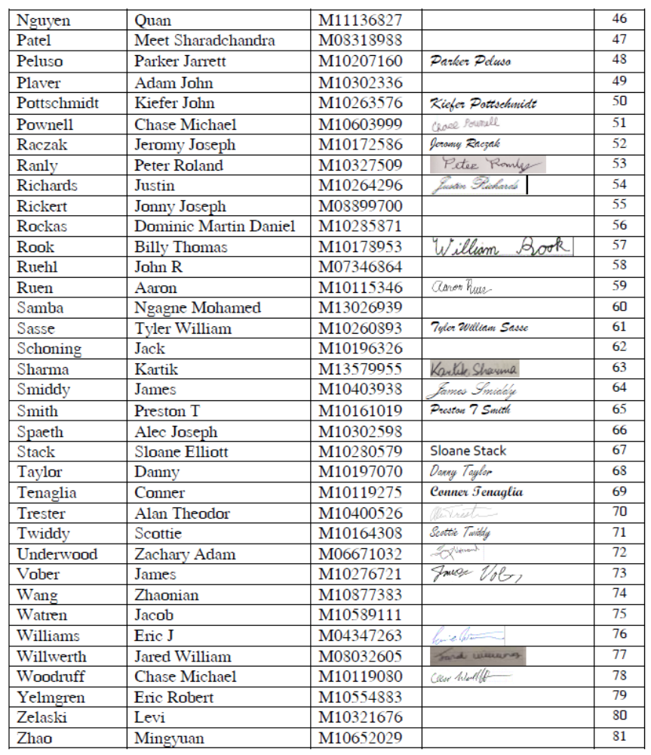
EECE5001 Week 2
Class List with Signatures

Slide 4
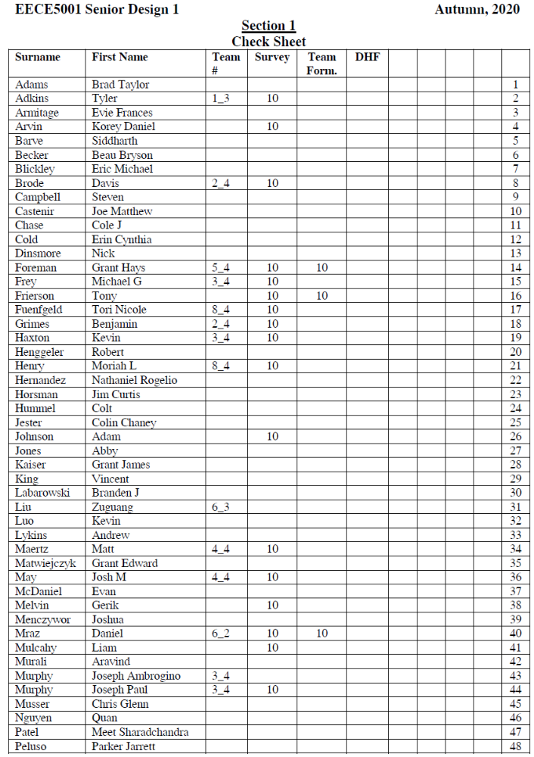
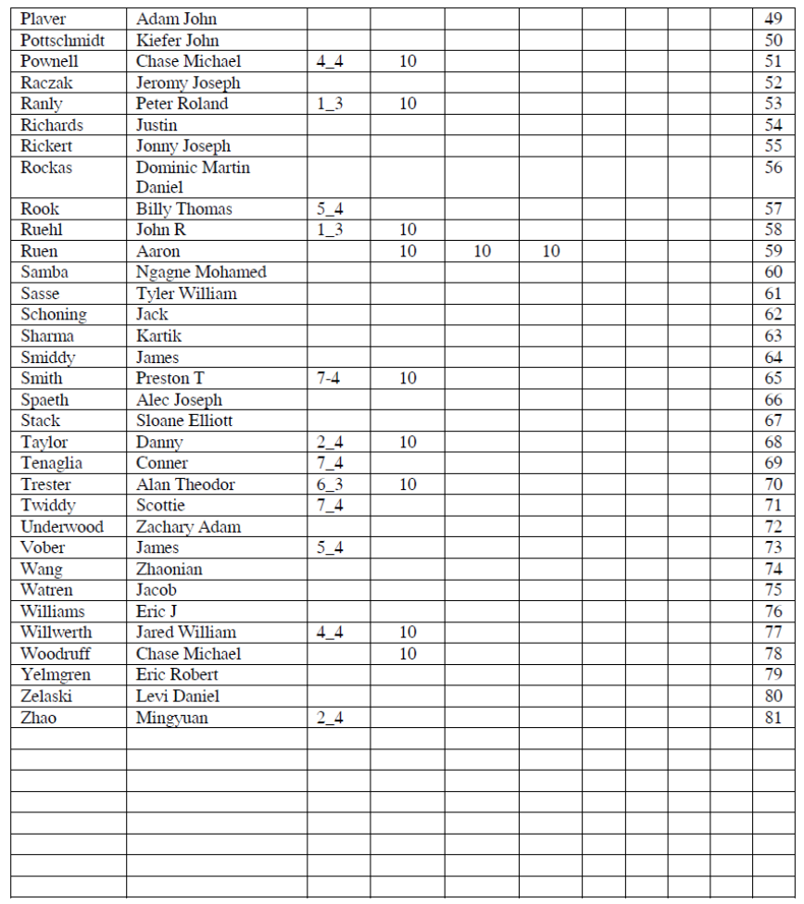
EECE5001 Week 2

Slide 5
EECE5001 Week 2
One Member of Existing Team gives 1-2 minute presentation
Number of students
Variety of tasks
Meeting times
Adviser(s)
Concept Source

Slide 6
EECE5001 Week 2
Each Student Without a Team gives 2 minute presentation
[of type of team wants to join, etc]
Experience sought
Future plans
Adviser goal(s) [internal versus external]
Development versus research

